Slide 1
Building DAPP-on Tron Blockchain Using React & Solidity
An Exploration of Blockchain Development

Slide 2
Introduction
Name: SYED HASNAIN SHAH REG : 23PWCSE2330 Section : C This presentation explores the development of a decentralized application (DAPP) on the Tron Blockchain using React and Solidity. It focuses on the implementation details and the learnings acquired during this project.

Slide 3
Table of contents
Project Overview
Initial Setup
Game Architecture
Smart Contract Development
Deployment
Testing and Validation

Slide 4
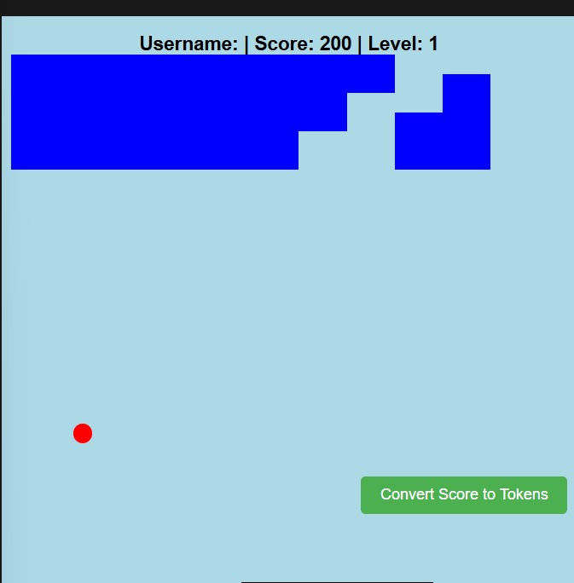
Project Overview
Developed a DAPP using React and Solidity. Focused on game mechanics within the Tron Blockchain. Created a game called 'BREAKOUT'.

Slide 5
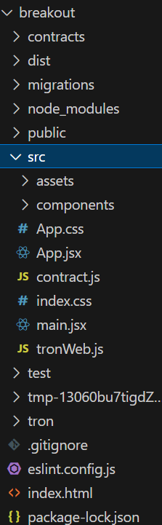
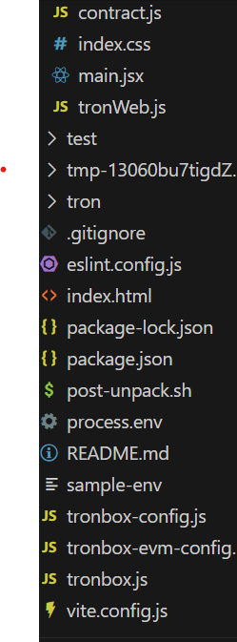
Initial Setup
Utilized npx create-react-app to initialize project files. Installed TronWeb using npm to interact with the Tron blockchain.

Slide 6
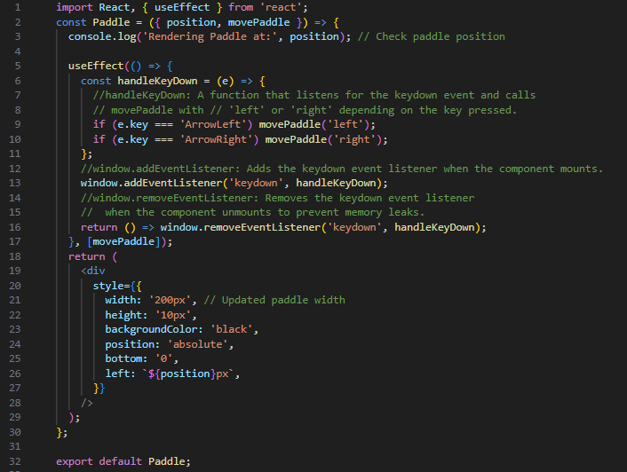
Game Architecture
Developed the Game Board component. Integrated key game components: Ball, Bricks, and Paddle. Defined game logic and interactions through React.

Slide 7
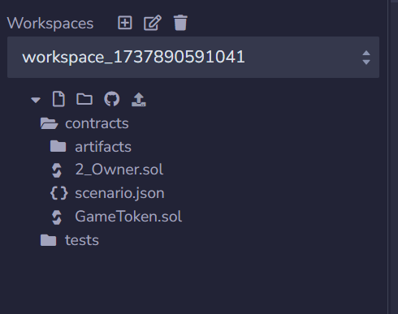
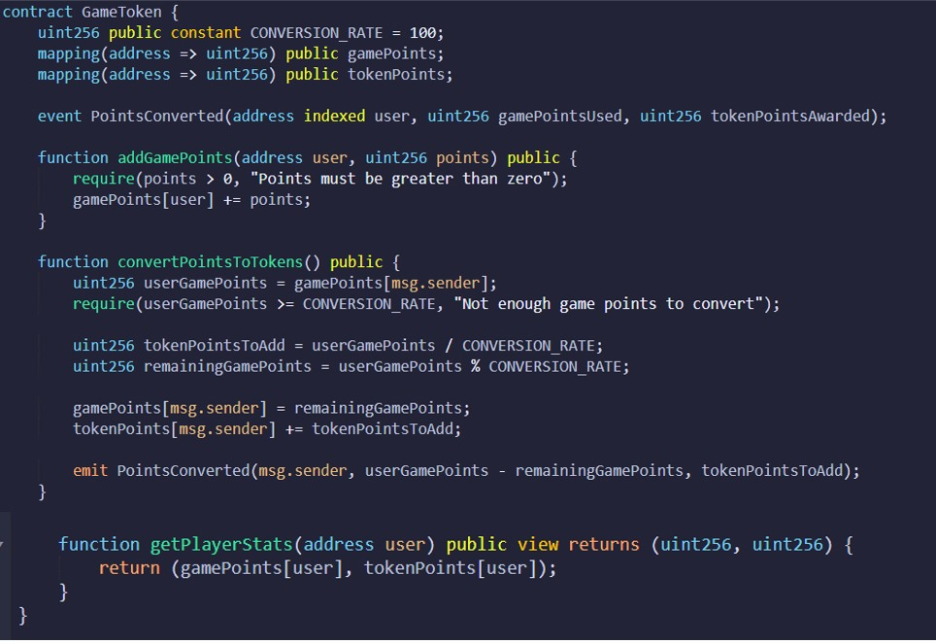
Smart Contract Development
Created Smart Contract: GameToken.sol. Implemented functions to convert game scores into tokens. Deployed contract on the Tron Shasta Testnet.

Slide 8
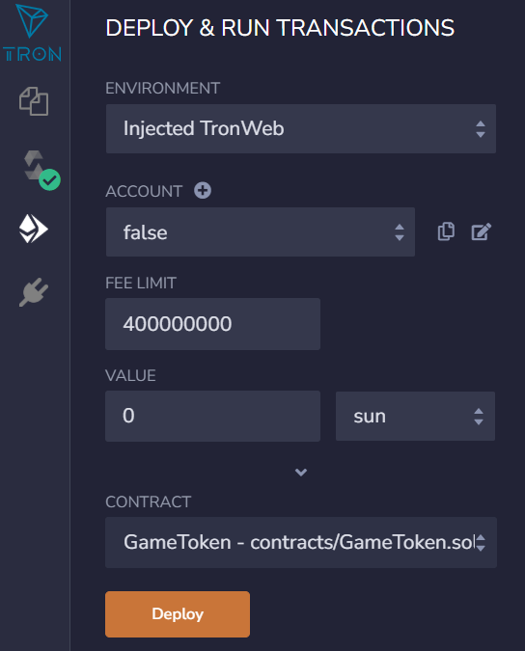
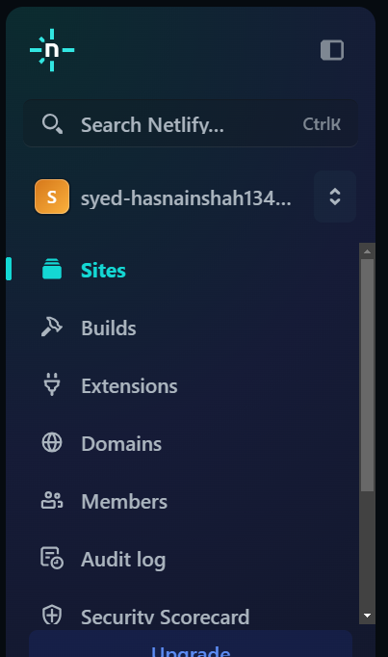
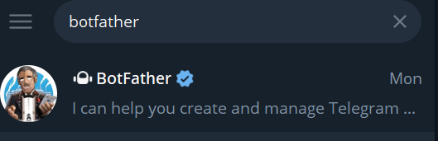
Deployment
Deployed DAPP using Netlify for hosting. Created a Telegram bot for user interactions. Ensured smooth integration between the frontend and blockchain.

Slide 9
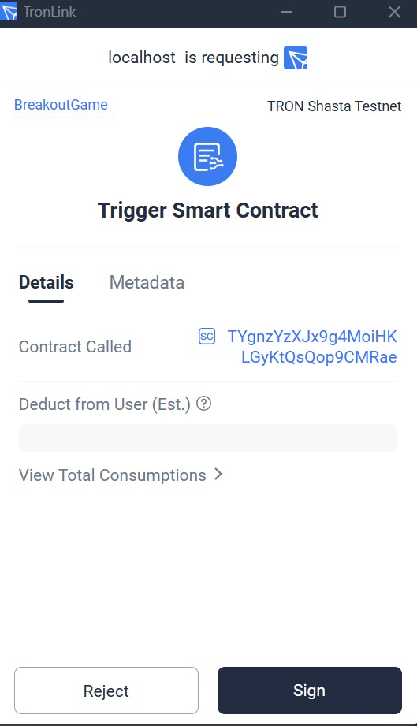
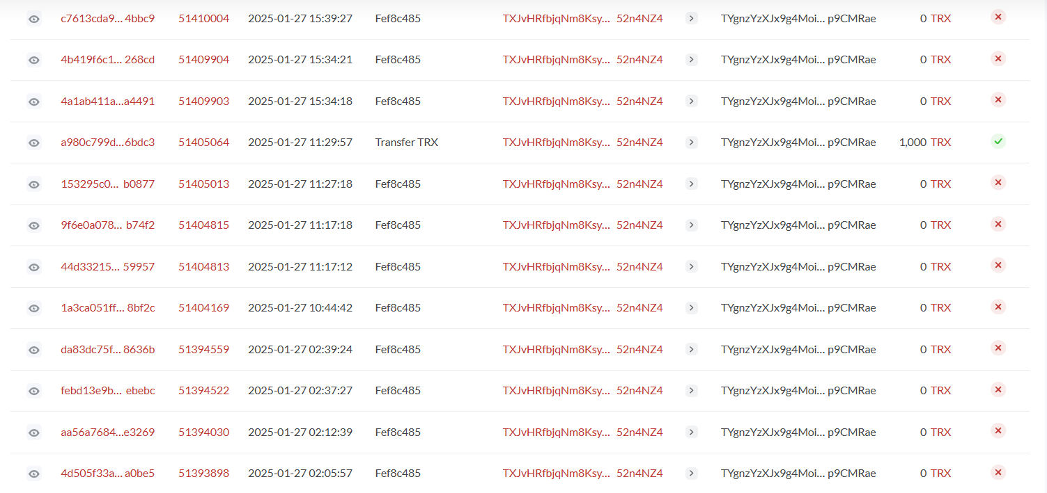
Testing and Validation
Conducted full testing of the game functionality. Verified backend transactions on the blockchain. Checklist includes testing the Convert Score to Tokens function.

Slide 10
Conclusion
This project enhanced my understanding of blockchain technology and development. The experience gained will be invaluable in future projects within this domain.

Slide 11
References
Tron Development Resources
React and Solidity Documentation

Slide 12
Thank you!

